Slide 1

Institute of Technology of Cambodia
Subject : Data mining
Project : Used car price prediction
Lecturers : CHAN Sophal and PHAUK Sokkhey
Name: CHHOEM Sothy

Slide 2
Content
Introduction
Dataset
Feature selection
Feature Selection
Split the data
Test model
Result

Slide 3
Introduction
The price of a new car in the industry is fixed by the manufacturer with some additional costs incurred by the Government in the form of taxes. So, customers buying a new car can be assured of the money they invest to be worthy. But, due to the increased prices of new cars and the financial incapability of the customers to buy them, Used Car sales are on a global increase. Therefore, there is an urgent need for a Used Car Price Prediction system which effectively determines the worthiness of the car using a variety of features.

Slide 4
Dataset
100,000 used car data from kaggle
selection of used car data set is data from buying and selling used cars in the uk. there are 108540 data from 10 types of cars. the data set used in this work consists of 9 indicator parameters. the data sets used in this work consist of 9 indicator parameters. these parameters as model year price transmission mileage fueltype tax mpg enginesize.
https://www.kaggle.com/datasets/adityadesai13/used-car-dataset-ford-and-mercedes

Slide 5
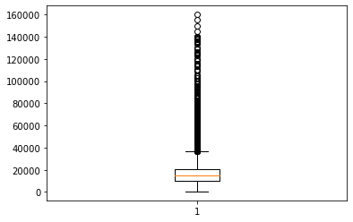
Data Visualization
Boxplots are a great tool for data visualisation, they can be used to understand the distribution of your data, and whether any outliers are present. A box is then formed between the 25th and 75th percentiles (Q1 and Q3 respectively). The range represented by this box is known as the interquartile range (IQR).
In this. data visualization, we will look for outlier in column price.

Slide 6
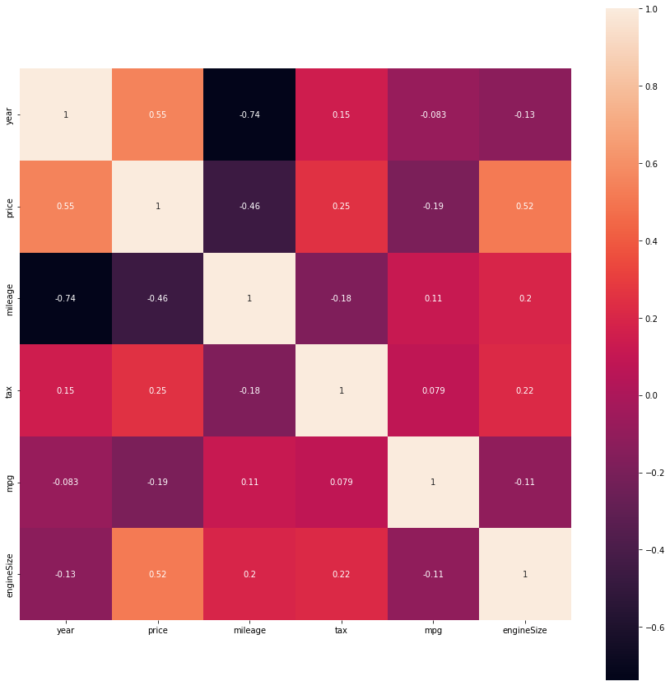
Data Visualization
Heatmap of 6 features with Seaborn
Correlogram is a correlogram replaces each of the variables on the two axes with numeric variables in the dataset. Each square depicts the relationship between the two intersecting variables, which helps to build descriptive or predictive statistical models.

Slide 7
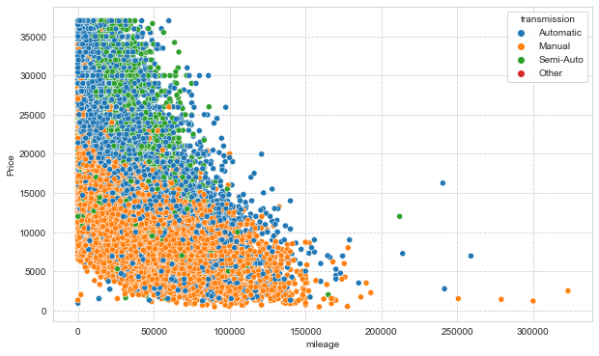
Data Visualization
A scatter plot is a diagram where each value in the data set is represented by a dot.
Scatter Plot by Selecting 2 Features price and mileage to Represent
7

Slide 8
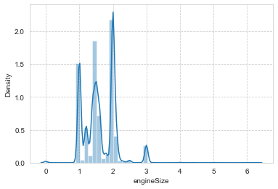
Data Visualization
A Dispersion Plot, also known as a Distplot, displays the variance in the original dataset. The total dispersion of a real-time data parameters is shown by the distplot() function of the Seaborn framework. It provides a high-level interface for drawing attractive and informative statistical graphics.
8

Slide 9
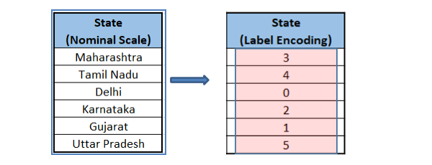
Other Data Visualization
Label Encoding is a popular encoding technique for handling categorical variables. In this technique, each label is assigned a unique integer based on alphabetical ordering.

Slide 10
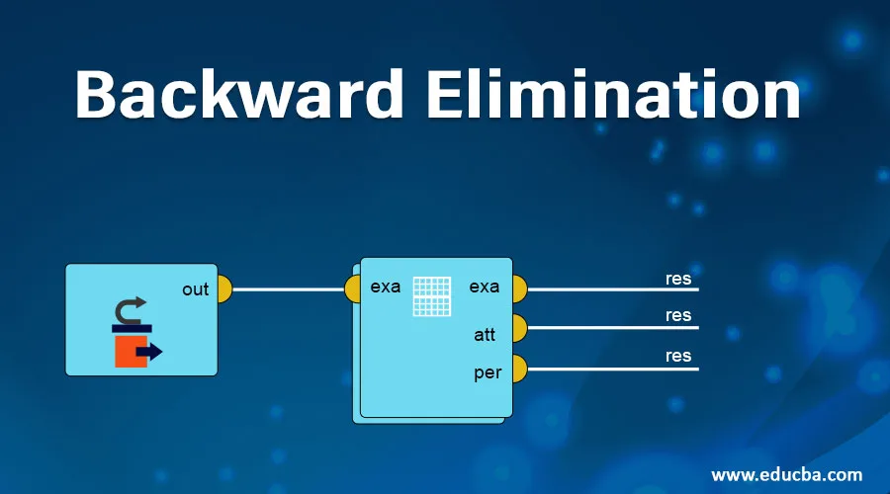
Feature Selection
Backward Elimination s a feature selection technique while building a machine learning model. It is used to remove those features that do not have a significant effect on the dependent variable or prediction of output.

Slide 11
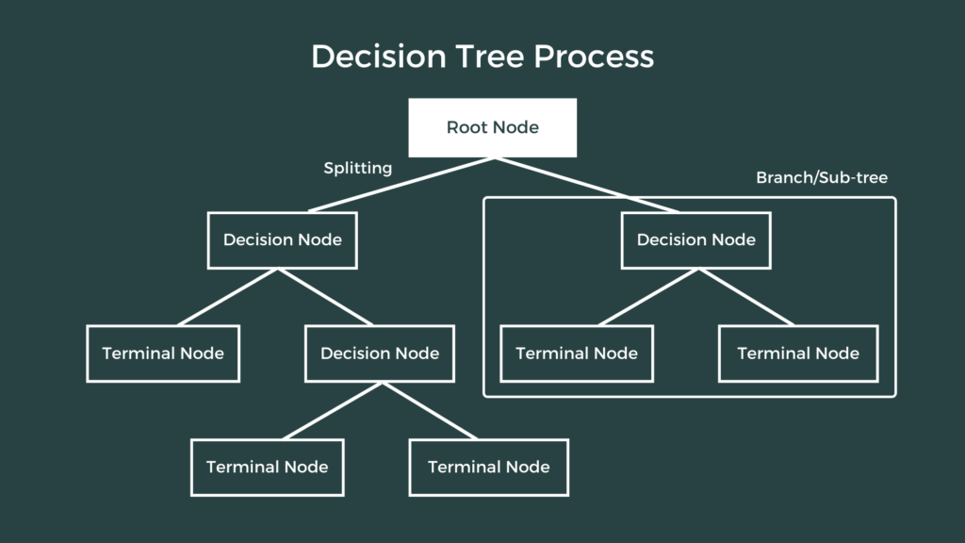
Machine Learning model
Decision tree regression
Decision tree algorithm creates a tree like conditional control statements to create its model hence it is named as decision tree.
Decision tree regression observes features of an object and trains a model in the structure of a tree to predict data in the future to produce meaningful continuous
Decision tree machine learning algorithm can be used to solve both regression and classification problem.

Slide 12
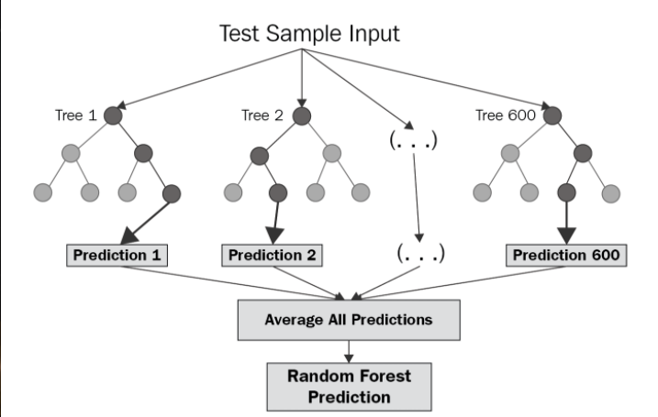
Machine Learning model
A random forest regressor.
Random forest is a meta estimator that fits a number of classifying decision trees on various sub-samples of the dataset and uses averaging to improve the predictive accuracy and control over-fitting.
12
12

Slide 13
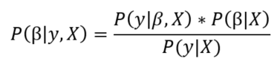
Machine Learning model
Bayesian Ridge regressor
Bayesian regression allows a natural mechanism to survive insufficient data or poorly distributed data by formulating linear regression using probability distributors rather than point estimates.
The output or response 'y' is assumed to drawn from a probability distribution rather than estimated as a single value.

Slide 14
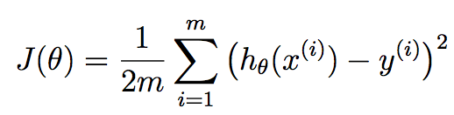
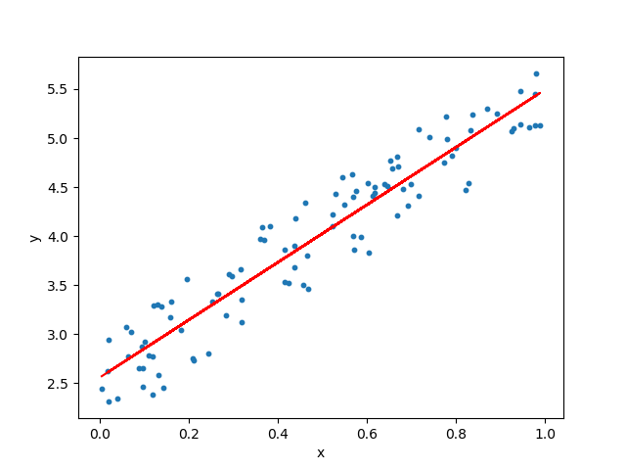
Machine Learning model
Linear Regression
Linear Regression is a machine learning algorithm based on supervised learning. It performs a regression task. Regression models a target prediction value based on independent variables.

Slide 15

Methodology
Split data into 2 main sets: Training Set for 85% and Testing Set for 15%
Using Standard Scaler for scaling the features according to this formula:

Slide 16


Methodology
Mean squared error (MSE) measures the amount of error in statistical models. It assesses the average squared difference between the observed and predicted values.
The mean absolute error of a model with respect to a test set is the mean of the absolute values of the individual prediction errors on over all instances in the test set.

Slide 17
Methodology
Model 1 : Linear Regression
Model 2 : Bayesian Ridge regression
Model 3 : Decision tree regression
Model 4 : A random forest regressor

Slide 18
Result
Model | Train score | Test score | Mean Squared Error | Mean Absolute Error
Model 1 | 0.772039283760268 | 0.771644224586841 | 0.2248301419970584 | 0.3663091655471483
Model 2 | 0.772039280677147 | 0.771644086490055 | 0.22483027796173877 | 0.3663092306808286
Model 3 | 0.963289526039309 | 0.94310970124264 | 0.05601195732724744 | 0.16608340935645155
Model 4 | 0.992713000874596 | 0.950307256449618 | 0.048925526706919055 | 0.150464959857278

Slide 19
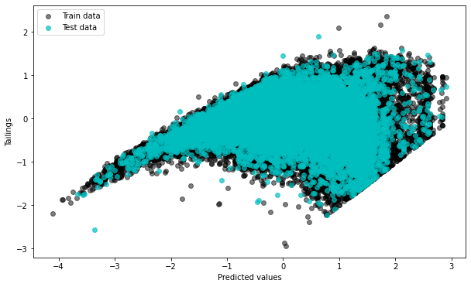
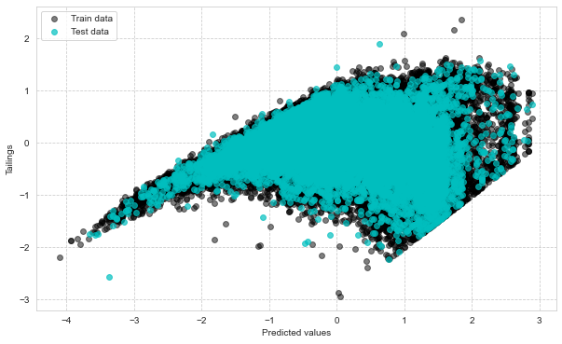
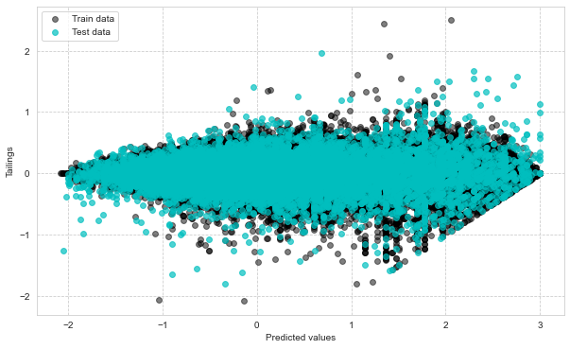
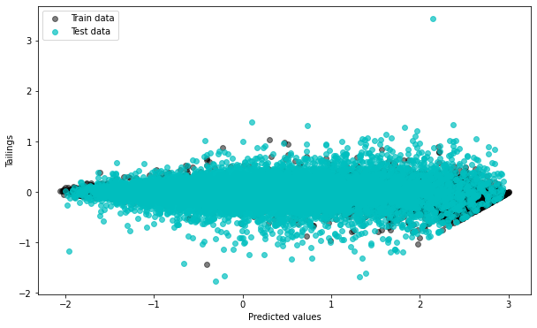
Result
Model 1 Model 2
Model 3 Model 4

Slide 20
Conclusion
• Cleaning Data
• Understand on how to do preprocessing and visualization
• Successfully implemented the models and evaluation
• Learn from assignment
• Know about advantages of data

Slide 21
Thank you!

